Slide 1
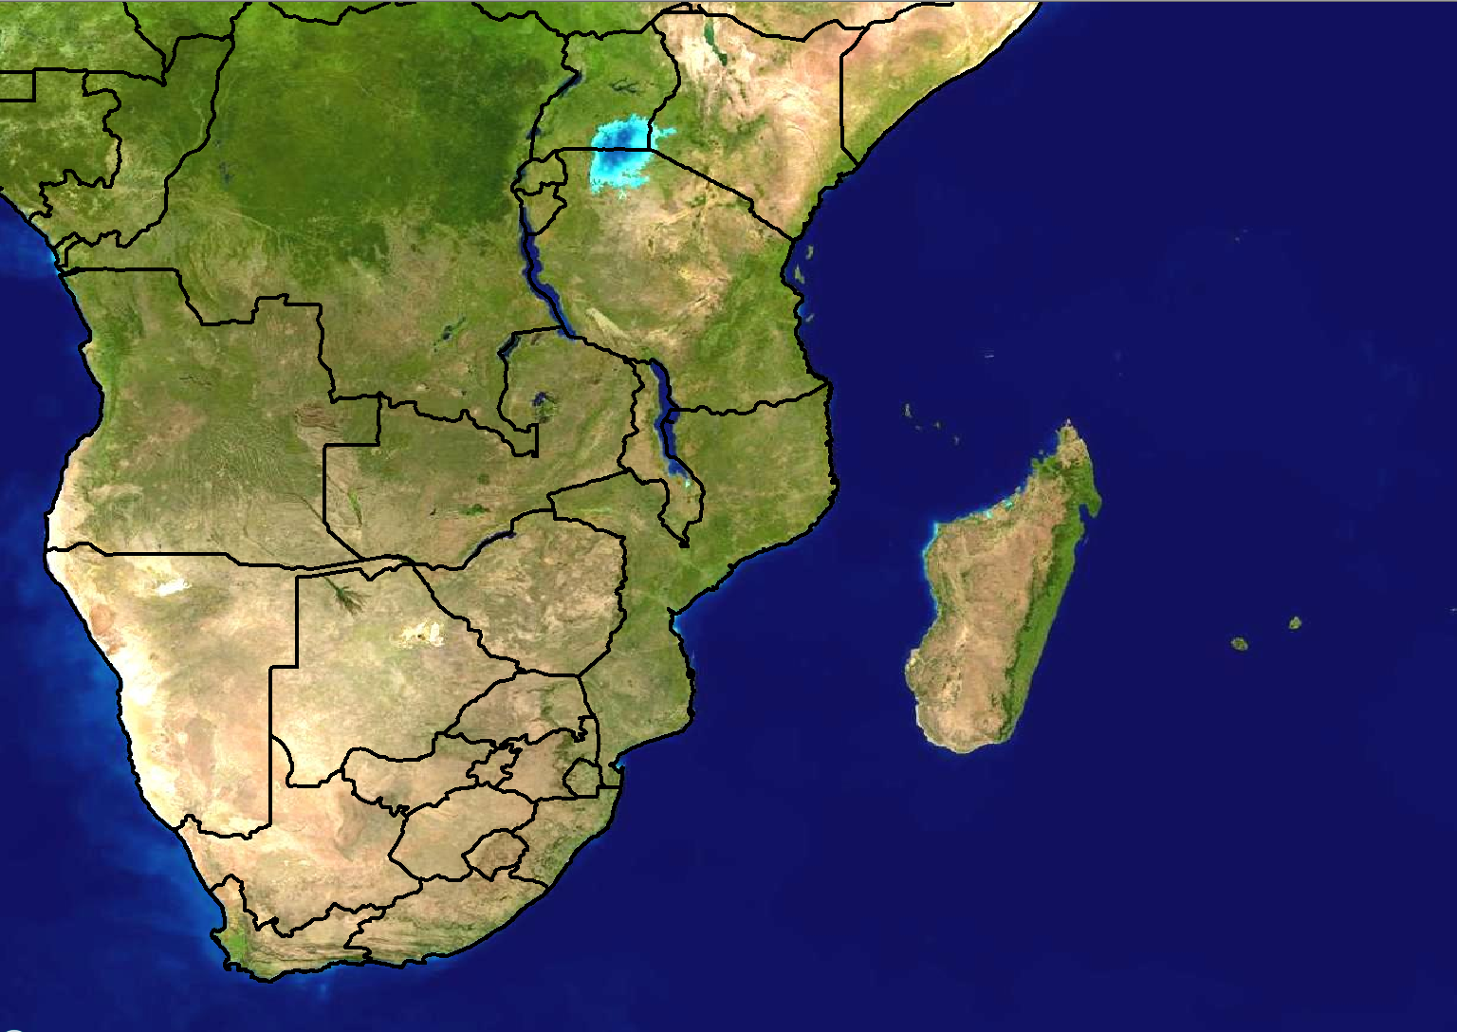
Scenario 1: Forecast for Day 3
24 hour rainfall (mm)
>100
80-100
60-80
40-60
20-40
Forecast issued:
Monday 20 February
Forecast valid:
Wednesday 23 February

Slide 2
Scenario 1 - Additional information:
There is a tropical cyclone ‘Camilla’ that is currently situated over the Comoros
The latest forecast from RSMC La Reunion shows that Camilla should move to Pemba, Mozambique on Wednesday, however there is a lot of uncertainty in this exact position at this stage.

Slide 3
Scenario 2: Forecast for Day 1 (Today)
24 hour rainfall (mm)
>100
80-100
60-80
40-60
20-40
Forecast issued:
Wednesday 23 February Forecast valid:
Wednesday 23 February

Slide 4
Scenario 2 - Additional information:
RSMC La Reunion has updated the forecast
The latest forecast shows that Camilla is now expected to be around Dar es Salaam at midday today.
Camilla has however weakened slightly, but rainfall amounts are still expected to be quite high.
Models are in agreement with 24 hour rainfall amounts of 80-100mm along the coast and adjacent interior between Dar es Salaam and Tanga.
The Unified Model (12km) shows 6 hourly rainfall amounts of >100mm between 12-18Z while Aladin shows >200mm over the same period.
There are a lot of tourists currently on Zanzibar Island and there is concern if and when they will be able to return home.

